Slide 1

The Local Train A project on music band website
Name | Lib Id | Branch
Abhimanyu Singh | 2428CSIT358 | CSIT
Deepanshu Sachdeva | 2428CSIT2183 | CSIT
Department of Computer Science and Information Technology
KIET GROUP OF INSTITUTIONS, GHAZIABAD, UTTAR PRADESH

Slide 2
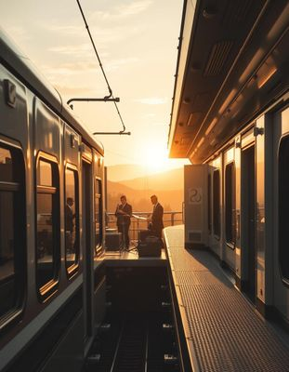

The Local Train: A Musical Journey
Welcome to the world of The Local Train, a band that's captivating audiences with its heartfelt music and raw energy. Prepare to embark on a musical journey that resonates with your soul.
By Deep Sachdeva &
Abhimanyu Singh
A

Slide 3
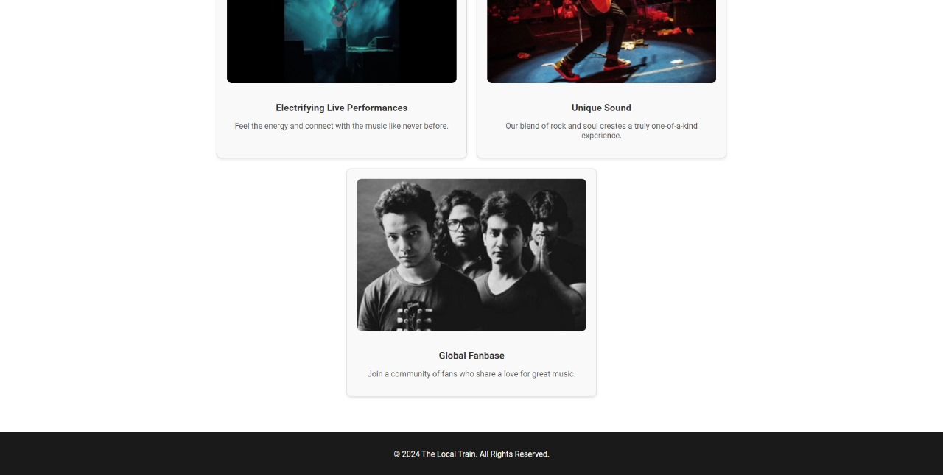
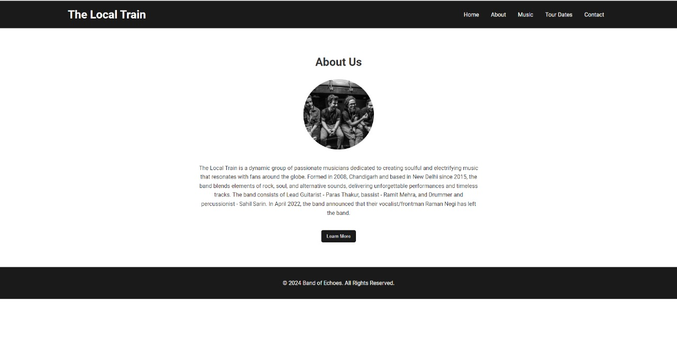
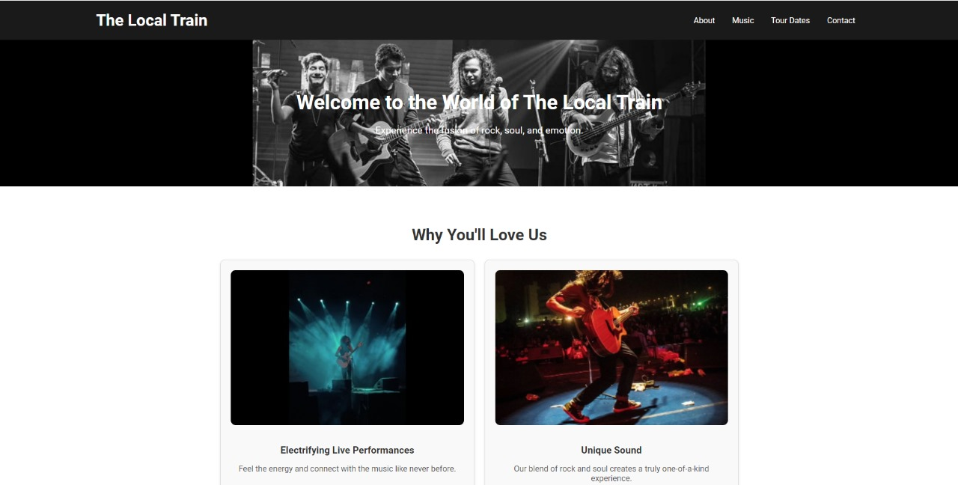
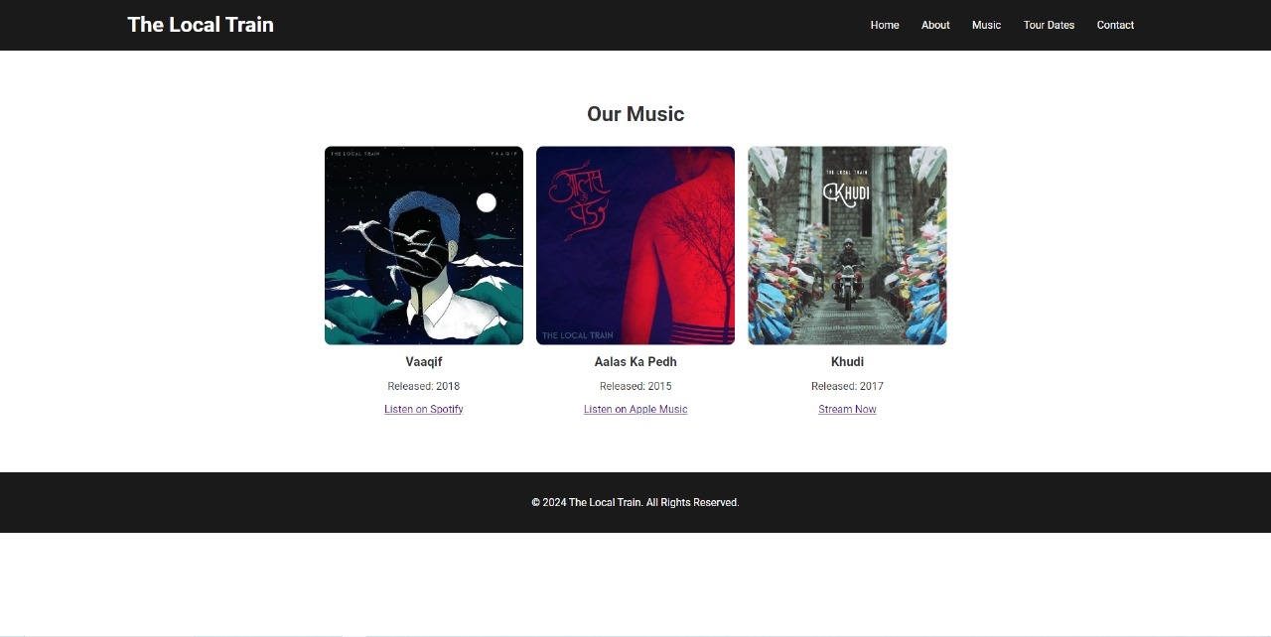
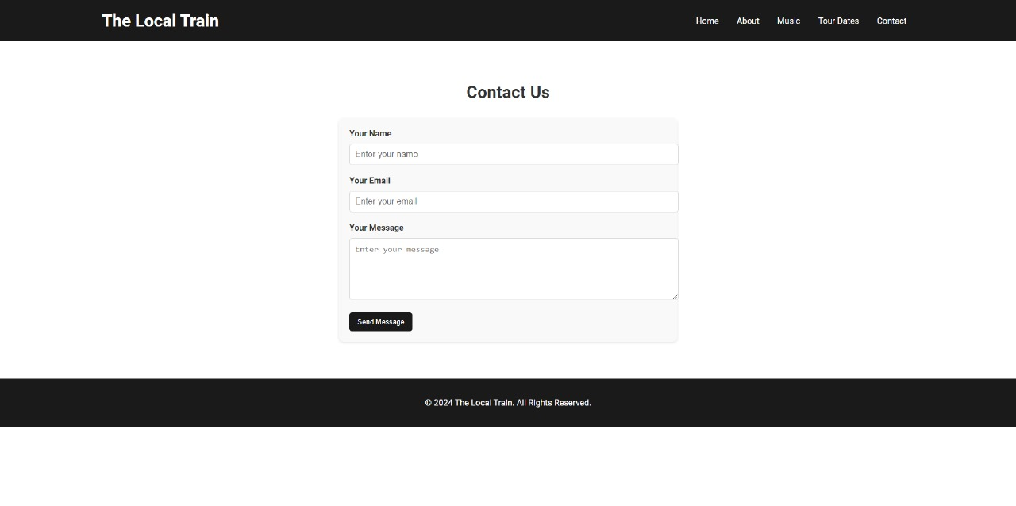
The website looks like this

Slide 4
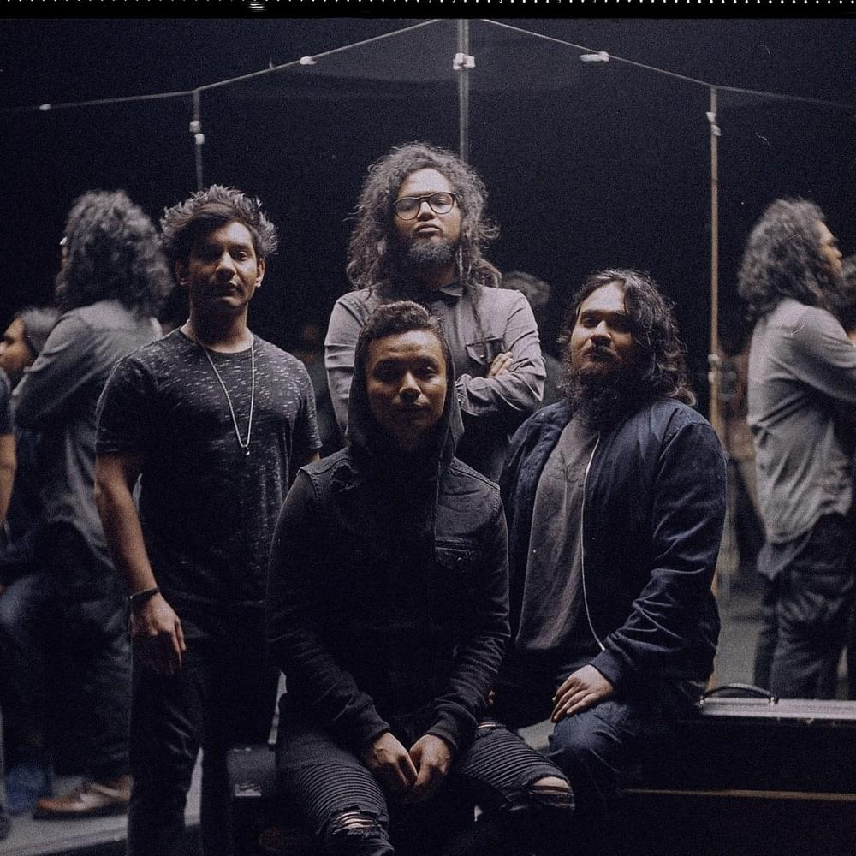
Our Musical style
Indie Rock
With its raw energy and emotional depth, The Local Train's music carries a distinctive indie rock influence.
Folk
Their music incorporates elements of folk, drawing inspiration from traditional sounds and storytelling.
Pop
The band infuses their music with pop sensibilities, creating catchy melodies and memorable hooks.
Emotional Depth
The Local Train's music is deeply personal, exploring themes of love, loss, and the complexities of life.

Slide 5
The local Train “The love of world”
Aalas Ka Pedh (2015)
The Local Train's debut album, Aalas Ka Pedh, introduced their sound to a wider audience, establishing their place in the Indian music scene.
Khudi (2016)
Khudi, further solidified their identity, capturing a more introspective and mature sound.
Vaaqif (2018)
Blind, their third album, explored themes of love and vulnerability, featuring a mix of mellow and energetic tracks.

Slide 6
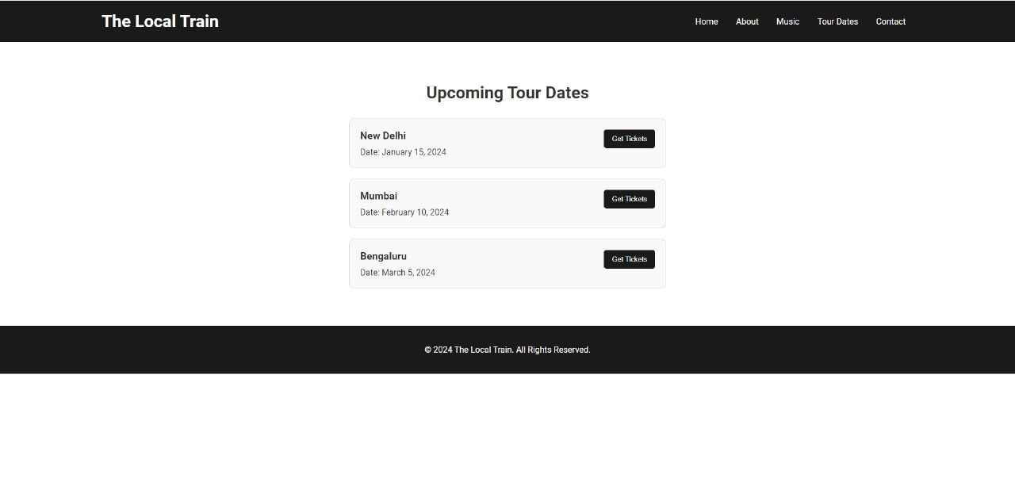
UPCOMING PERFORMANCES
Delhi
Join us for a live concert in the heart of Delhi on [15 Jan 2025] .
Mumbai
We're bringing our music to Mumbai on [10 February 2025] get ready for a night of unforgettable melodies.
Bangalore
The Local Train is hitting Bangalore on [5 March]. Get your tickets now!

Slide 7
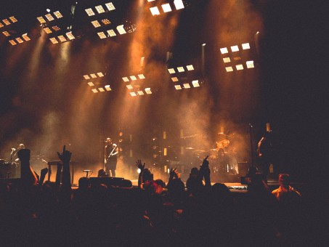
Mainly CSS Tags used :
Padding – For spacing around the form elements.
Margin – To adjust spacing between form fields.
Border – For texts fields and buttons.
Text-align - Specifies the horizontal alignment of text
Font-family – Specifies the font type to be used for text

Slide 8
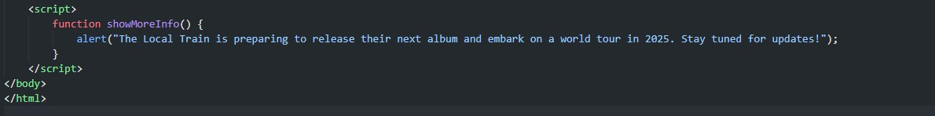
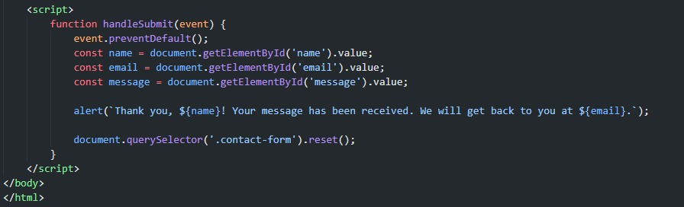
Java script Tags used here:

Slide 9
EMPATHIZE
Users : Music enthusiasts, General critics, Music lovers. Want to know more about the music band.
WHAT THEY SEE:
User-friendly website with organized different sections regarding the music band.
WHAT THEY THINK/FEEL:
“There are not many good websites that tells you about the music band and their background and doesn’t let fans send messages to them.”
Pain Points:
Gap between fans and The Music band.
Desired Gains:
Users would want to connect and send messages to their favourite music bands etc.

Slide 10
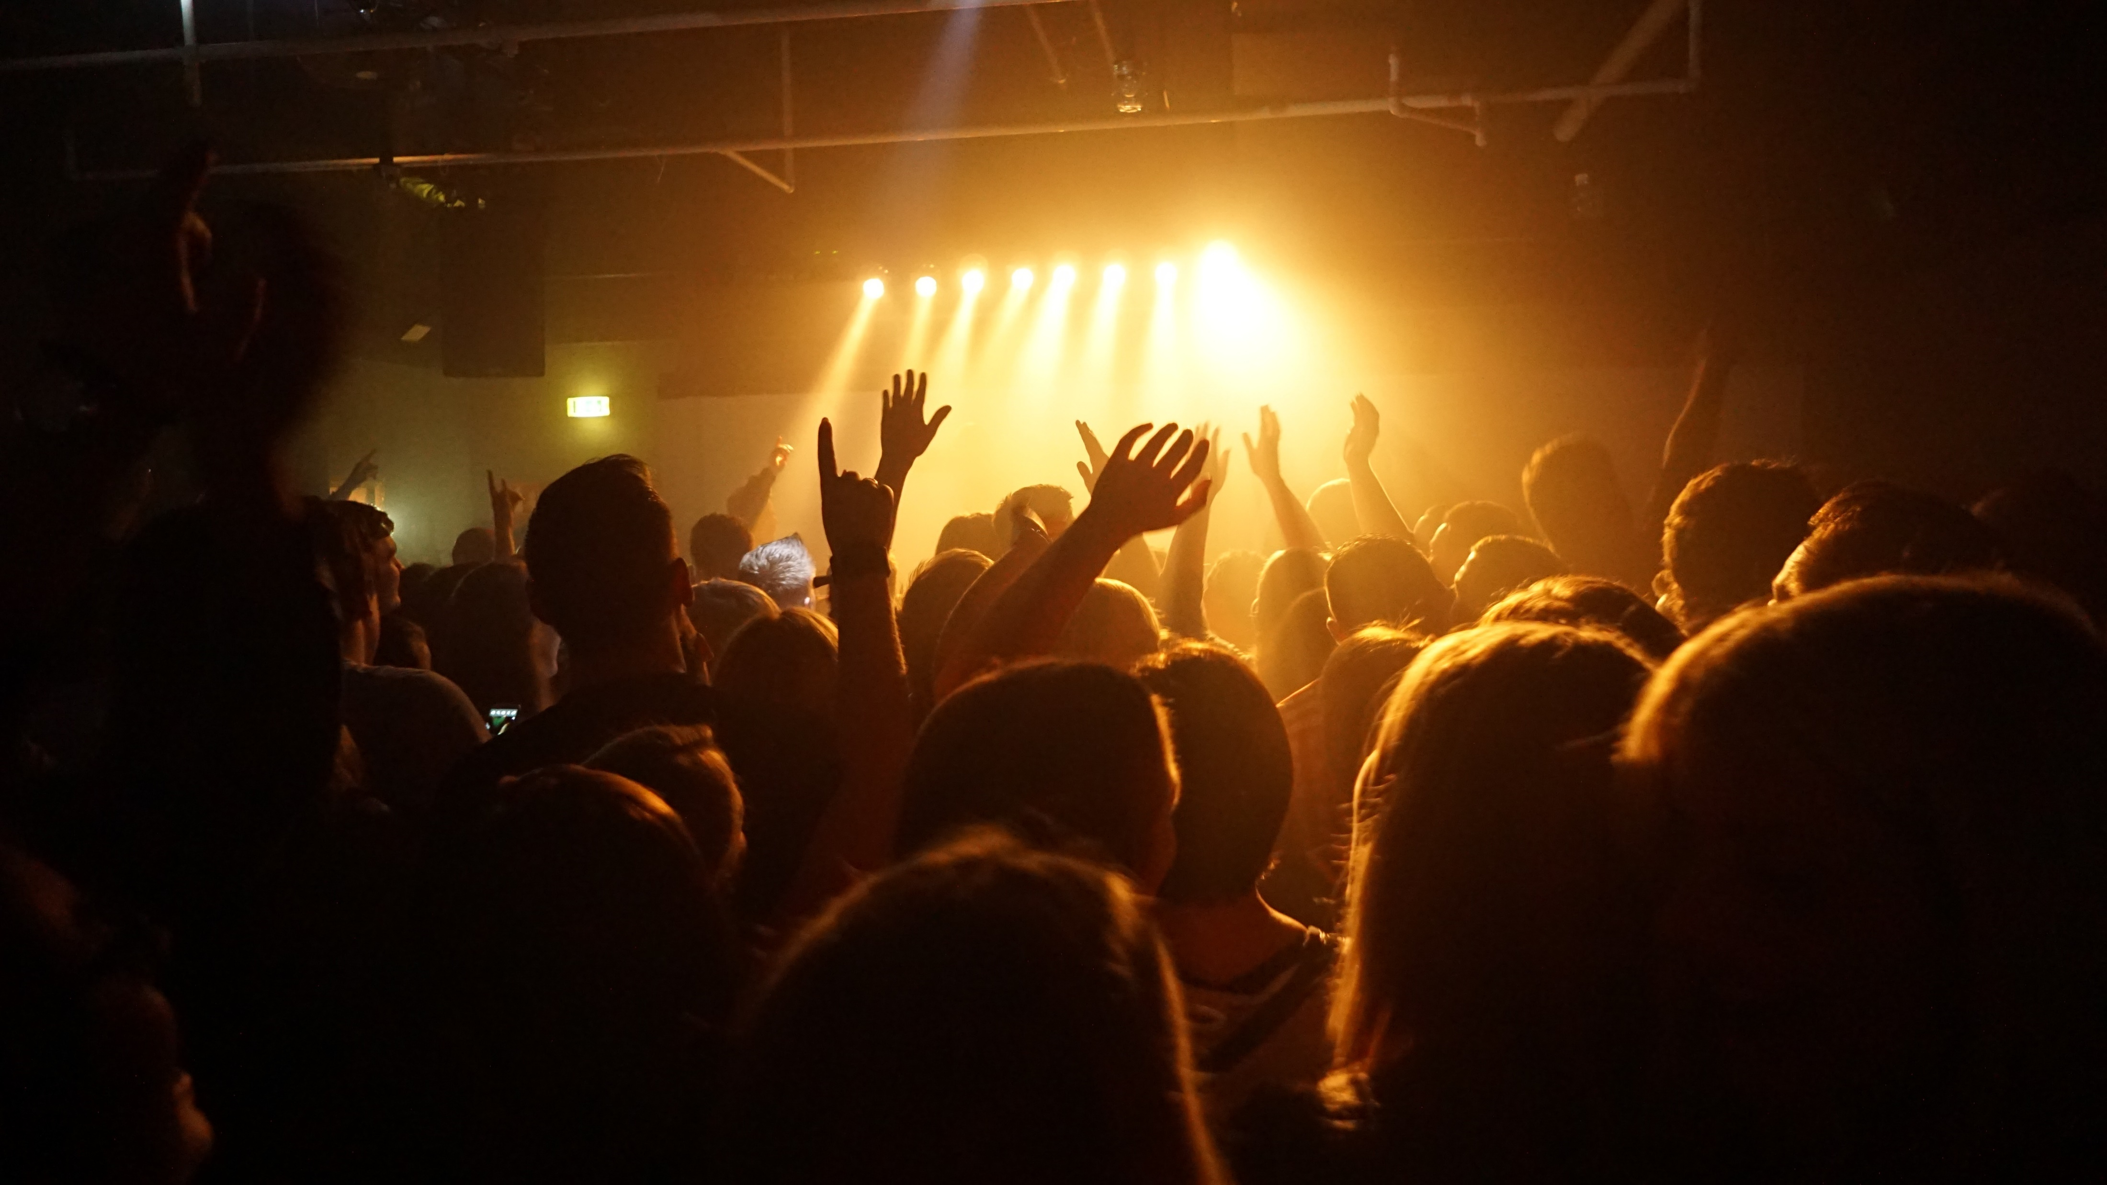
A huge thank you to all guys shows that their love towards music –”A Great sol of patience “
Thank you so much

